Slide 1






Music Symbols recognition
and music patterns extraction
Presented by
Benammar Riyadh

Slide 2
Plan
1- Introduction to music theory
2- Music symbols recognition
3- Music sequence mining
4- Preliminary results
5- Conclusion

Slide 3
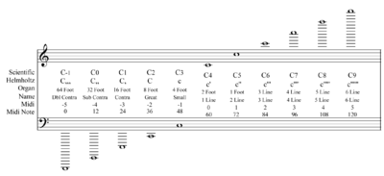
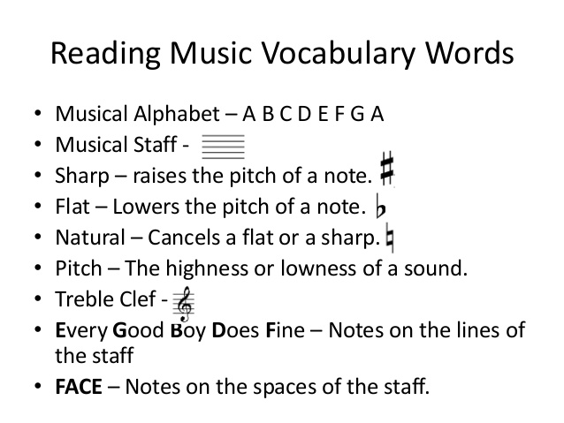
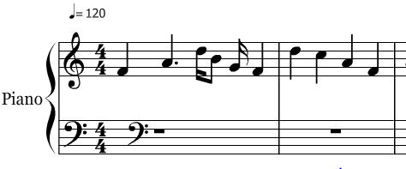
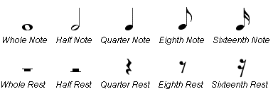
Music Theory
“Music is an art form consisting of sound and silence” - Wikipedia
“Music theory is the study of the practices and possibilities of music. It generally derives from observation of how musicians and composers make music” - Wikipedia
Music vocabulary consist of standard symbols (clef, meter, pitch, rhythm, etc.) that define an universal music language
Music score is a set of measures, delimited by vertical bar lines, put on one or many staves (5 horizontal lines) depending of number of instruments. Each measure contains a set of pitches.
A note can take values (C, D, E, F, G, A, B) with different duration type. It can have also
an alteration (flat, # or natural)

Slide 4
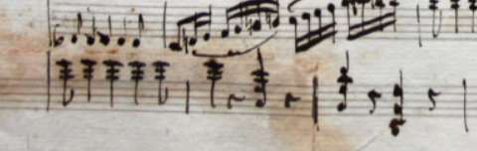
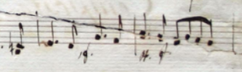

Needs
Music is very old science (dating from the prehistoric period)
Old music creations risks natural degradation
ISH-Lyon digitized set of old scores and make manual transcription -> tedious task and needs humain and time resources
Challenges:

Slide 5
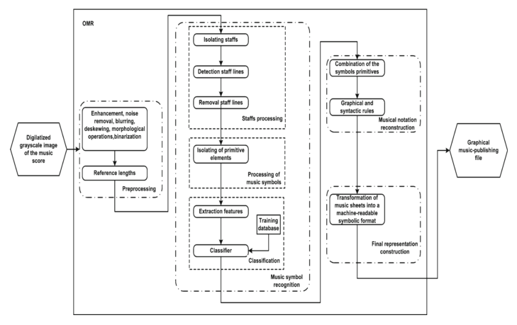
Optical Music Recognition (OMR)

Slide 6
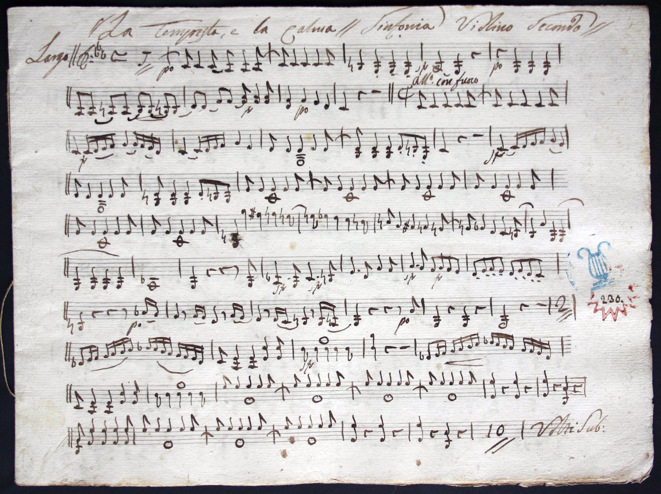
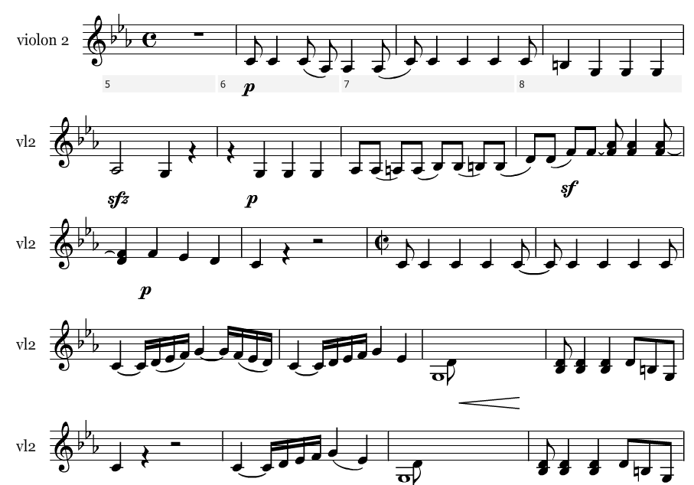
Available data
Scanned image scores
Music Scores transcription
Music symbols recognition (OMR process)
Music patterns extraction

Slide 7
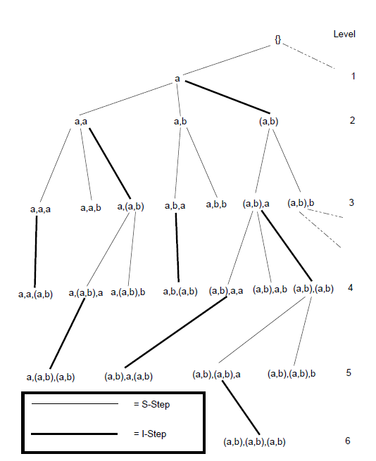
Sequence patterns Extraction
SPAM (proposed by [1] ) is an algorithm for discovering sequential
patterns
Based on depth first search with pruning thanks to Apriori
monotony property
A sequence is a set of itemset, an itemset is a set of ordered items
without redundancy
The algorithm build up a tree such as for each level it adds either
an item (I-Step) or a sequence (S-Step)

Slide 8
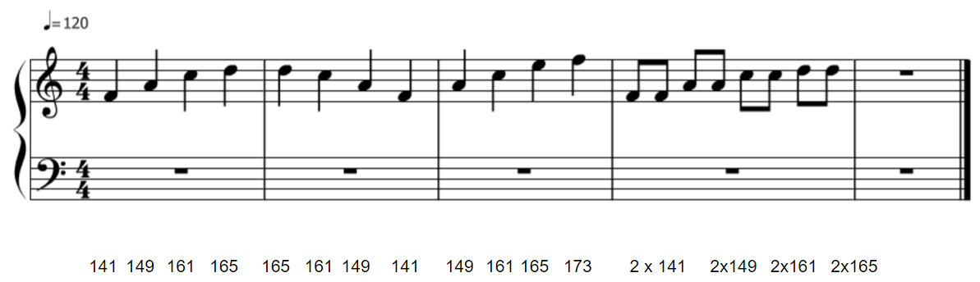
Music data adaptation for SPAM algorithm
First we transform symbolic information to binary representation (3 bits for octave, 3 bits for note value and 2 bits for alteration), then use its decimal value.
Here we are using only melodic information
Example: The pitch: E positioned on Octave 4 with # alteration will be coded 100 011 11 = 143
Sequence: itemset consists of four measures (fixed by our expert in Music) built using sliding window with two (temporary) measures of recovery
Inside each sequence, item set are built up using order of decimal values
sequence: <141 149 161 165> <161><149><141 149 161 165 173> <141><141 149> <149 161><161 165><165>
itemset

Slide 9
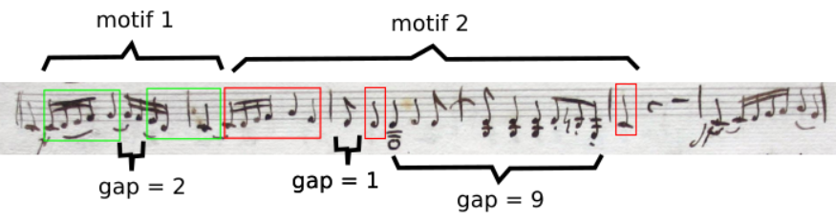
Preliminary results
Different patterns with variable length and frequencies
Ex: Pattern 1 and pattern 2 are considered as similar; our musicologue consider that this result is correct and notes forming the gaps are called ‘broderie’ in French

Slide 10
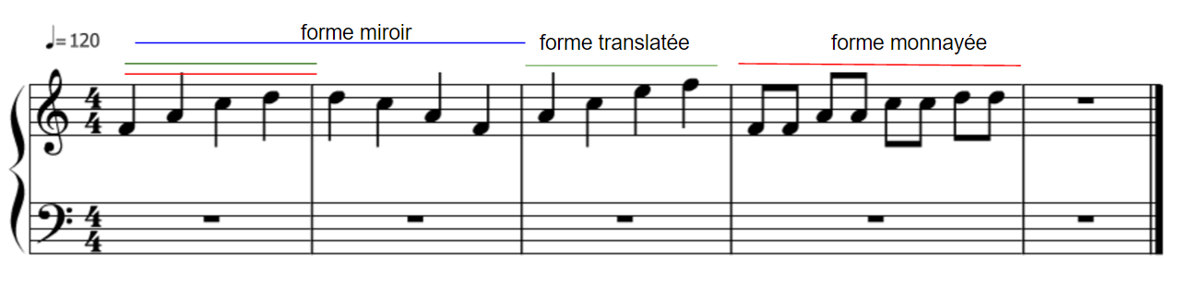
Other kind of patterns
Our challenge is to find a way to detect particular music forms with variants using SPAM algorithm
But there is rhythmic patterns and we have to propose a model that take into account both rhythmic and melodic information

Slide 11
Conclusion
Our goal is to develop a process in loop that allows us to recognize music symbols and extract frequent patterns
Music patterns can be used for theme classification, author identification, plagiarism detection, etc.
Propose a general model covering all kind of music information:
Graph representation with multi-label nodes
Possibly Combinatorial maps [2]
Build a GUI application to help musicians to assess our future results

Slide 12
References
[1] Jay Ayres et al., Sequential PAttern Mining using A Bitmap Representation - 2002
[2] Gosselin, S., Damiand, G., & Solnon, C. (2011). Efficient search of combinatorial maps using signatures. Theoretical Computer Science, 412(15), 1392-1405.

